Slide 1

Cap Stone Project
Exploring Coffee Quality Data with Power BI

Slide 2
Contents
Introduction of Cap Stone Project :- Exploring Coffee Quality Data with Power BI
Clean and Prepare the Dataset
Key Sensory Determinants
Processing Methods and Regions
Defects and Cup Score
Decomposition Tree

Slide 3
Introduction of Cap Stone Project :- Exploring Coffee Quality Data with Power BI
About the Coffee Quality Institute (CQI):
A non-profit organization founded in 1996, headquartered in California, USA.
Mission: Improve coffee quality and value through research, certification, and training.
Collaborates globally with growers, processors, and roasters.
About the Dataset:
Provided by CQI, focused on Arabica coffee quality.
Covers sensory evaluations, processing methods, bean defects, and origin details.
Sensory scores include aroma, flavor, acidity, aftertaste, body, balance, sweetness, and more.
Each sample is assigned a Total Cup Points score (sum of 10 sensory attributes).

Slide 4
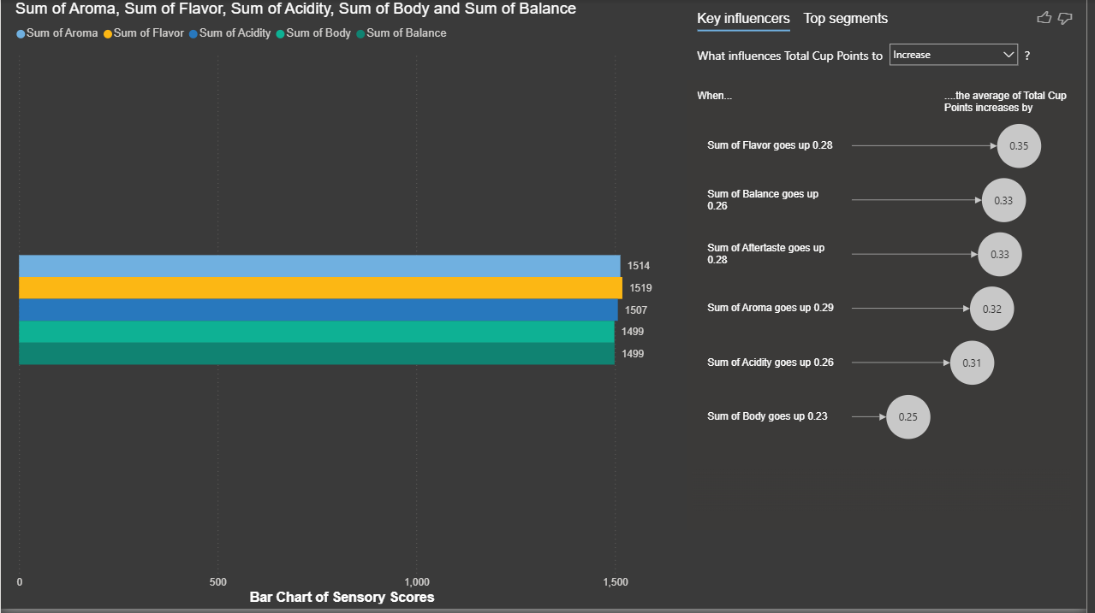
Key Sensory Determinants
Visual 1: Bar Chart of Sensory Scores
Visual: Clustered Bar Chart
Axis: Aroma, Flavor, Acidity, etc.
Values: Average of each field
Visual 2: Key Influencers
Add Key Influencer Visual
Analyze field: Total Cup Points
Add sensory fields as inputs

Slide 5
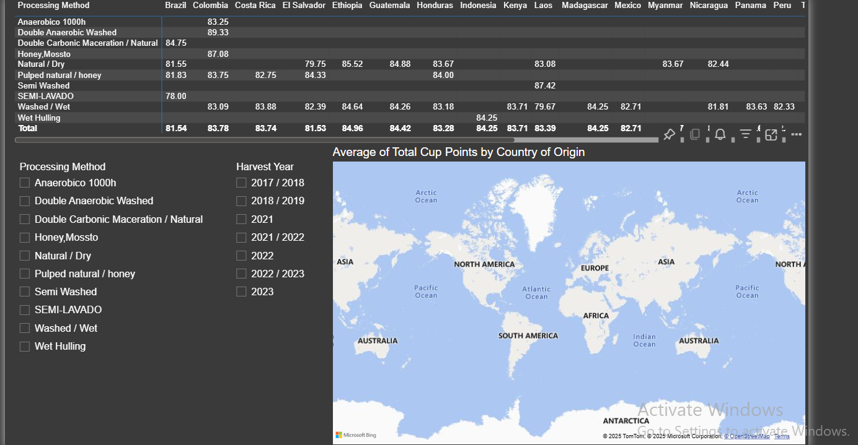
Processing Methods and Regions
Visual 1: Filled Map
Add Map visual
Location: Country of Origin
Value: Average of Total Cup Points
Visual 2: Matrix
Rows: Processing Method
Columns: Country
Values: Total Cup Points (Average)
Slicers:
Add Slicer Visuals for:
Processing Method
Harvest Year

Slide 6
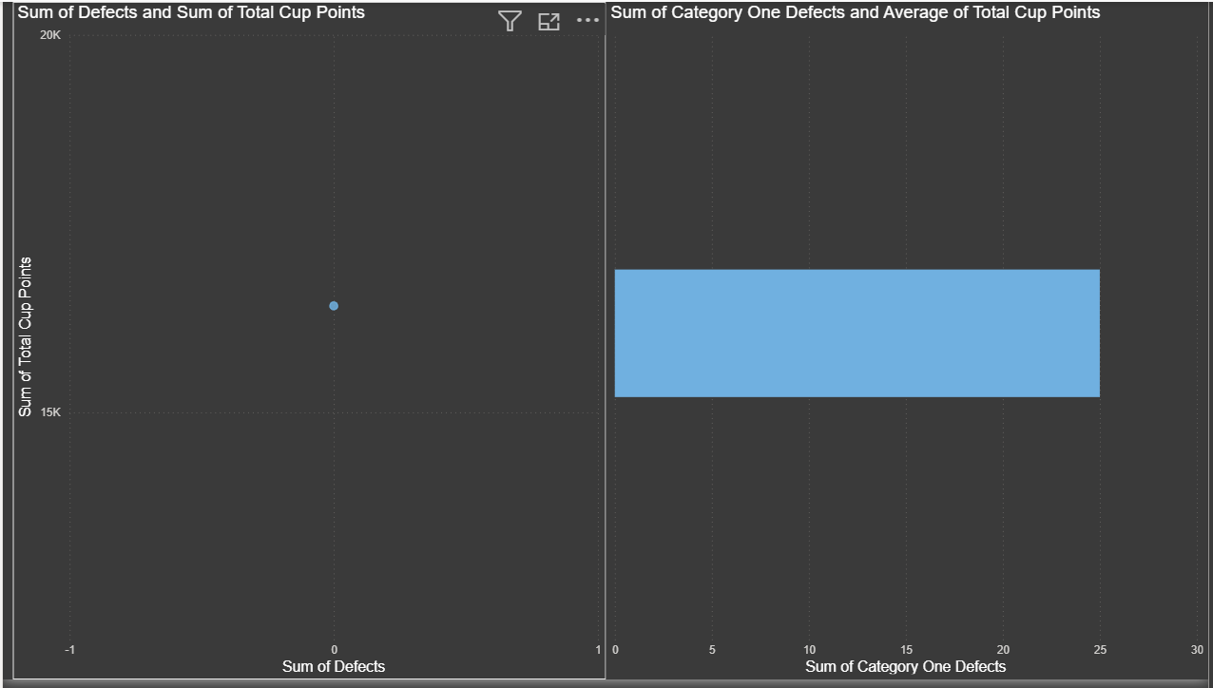
Defects and Cup Score
Visual 1: Scatter Plot
X: Total_Defects
Y: Total Cup Points
Visual 2: Bar Chart
Axis: Category One Defects
Value: Average Total Cup Points

Slide 7
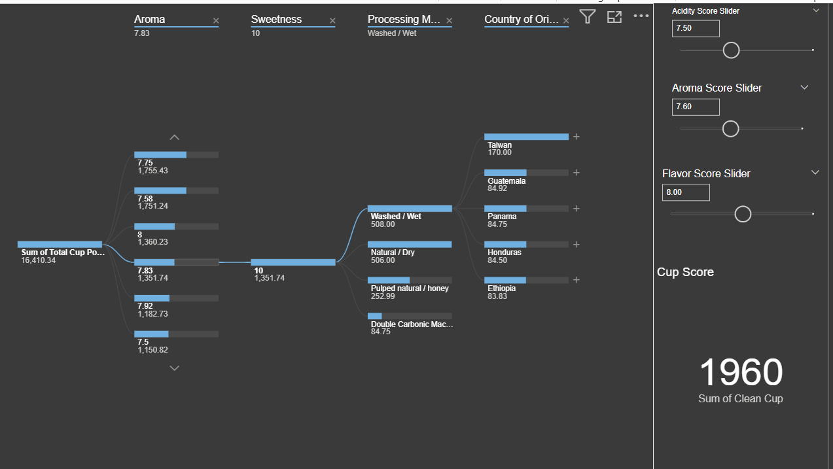
Decomposition Tree
Visual 1: Decomposition Tree
Analyze: Total Cup Points
Explain by: Aroma, Region, Sweetness, etc.
Visual 2: What-If Parameters
Go to Modeling → New Parameter
Name: "Aroma Score Slider", range 6 to 10
Create Measure:
DAX Code :
Simulated_Score =[Aroma Score Slider Value] +[Acidity Score Slider Value] +[Flavor Score Slider Value]

Slide 8


